Slide 1
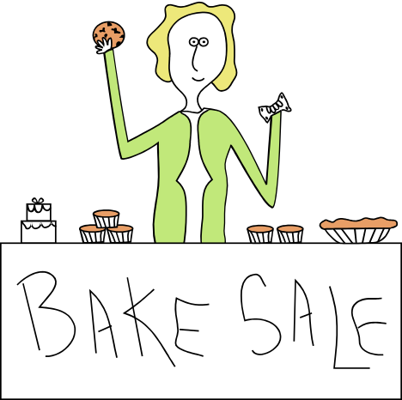
Volunteer Solutions
How We Motivate

Slide 2

Build it and they will come…
The Independent Sector Non-Profit Information Center reports that 86% of NPOs would use more volunteers if the volunteers had the skills the organization.
Couple that with The Youth Service America president showing that more youths today are volunteering more than any other generation before.

Slide 3
Motivation—How to do it
There are stages to volunteering /charitable giving. Just like the grieving process, there is a process to getting a motivated volunteer.
So, what are the stages of giving?
1.)

Slide 4

All About the Volunteer
We need to satisfy the interests and needs of the prospective volunteers, who like discriminating consumers, can choose from a wide range of options in the volunteer market.
Simply having a worthwhile cause and meaningful volunteer activities is no longer sufficient.

Slide 5


QUESTION?
  Why should I use the Triangle United Way as my point of contact for my volunteer opportunities as opposed to the actual organization itself?
  In other words- What can and will you do for ME?

Slide 6


ANSWER!
We have a strong knowledge of area charities and have a good and established working relationship with many of them. By using our Volunteer Matching System you are increasing your opportunity and chance of finding the right option for you specifically. We realize that the desire to volunteer your time and the limits of your daily life don’t always coincide. So, by filling out a Volunteer Profile, you are setting yourself up for the maximum benefit of our services with little effort on your part. You don’t have to scour the newspapers, or even our website, every day or week. We will email you the opportunities that best match your interests and availability. It all comes to you, and then in the privacy of your own home you can coordinate your volunteer experience to your liking.

Slide 7

Translation of Answer
We have just told the volunteer that:
We are looking out for your interests. We want you to have a positive experience and are committed to helping you do so.
You only have to fill out one application for your Volunteer Profile vs. the numerous individual applications for each charity.
You can make this work for you. You know yourself and your strengths best—tell us about it and we’ll do our best to find the right opportunity for you.

Slide 8

Pros and Cons-The Way the Volunteer Will See It
The benefits of volunteering are numerous.
Giving makes you feel good about yourself. When you’re volunteering, you’re distracting yourself from your own existence.
More fuzzily, giving puts meaning in your life. You have a sense of purpose because you matter to someone.

Slide 9

The Flip Side of the Warm Fuzzies
Volunteering is assessed in a Cost/Benefit analysis type of way for many. We need to be aware of this and plan to offset it.
Costs: time away from family, friends, hobbies, career; travel, childcare, meals, miscellaneous money; Expenses related to the volunteer position like materials or GAS money

Slide 10

How to capture a demographic?
Sneak up on em’
Museums are great at this. They bring young, school-aged children in and dazzle them with cool activities. These kids go home and rattle this off to their parents and get taken back to the museum. The parents are amazed that their child is engaged and behaving so well, they become regular visitors.
I didn’t really believe this, personally. Until I found myself standing in front of a show I had taken part in and asked the man in front of me why he was there. His response floored me.

Slide 11

Trends and Groups to Consider
Short-Term or Episodic: They are volunteer opportunities with definite start/end dates AND/OR occur at regular intervals such as annual events.
Family Volunteering: Increasingly families are looking for ways to spend time with each other while doing something meaningful or helpful.

Slide 12

Colleges and Interns: About 25% of colleges and High Schools require volunteering work in their curriculum.
Virtual Volunteering: Relatively untapped market. Ideas include “email buddies” and web site design that can be done from home.
People with Disabilities: Excellent, yet underutilized, source of talent. ADA provides for full participation and access to all aspects of society, including volunteering. 78% of disabled people say they would like to be involved in meaningful work.

Slide 13

Hitting the Right Market
Example: The inexperienced recruiter prints 5,000 brochures and THEN muses “where can I put these?” The more experienced, and effective, recruiter FIRST asks “where might I find the right volunteers for each job and then selects the best technique to match each potential source

Slide 14


Focus on the Family
Providing families with opportunities that allow them to interact as a family are the winning entries.
Most mothers make these decisions for the rest of the family (gender politics aside) and therefore the focus should appeal to their sensitivities.
Many women, particularly mothers, relate to and enjoy message boards that allow them to connect to other women/people in general. Have a message board for our volunteering experiences linked to popular sites like Ivillage.

Slide 15




Secrets of Success
Sincerity: Be honest about your program, its strengths/weaknesses and growth.
Passion: Have an exhibit passion for your program. Enthusiasm is contagious and your greatest recruitment tool.
Innovation: Be creative and flexible and have FUN.
Risk-Taking: Be willing to break the mold and investigate new management structures.

Slide 16




Inclusiveness. Be welcoming and empowering of others.
Thinking Like a Visionary. Envision the way things could be, not just the
way they are and think strategically.
Be an Eagle and not a Turkey Buzzard to keep volunteers motivated and returning, because once you’ve lost them it’s almost impossible to get the back!

